Slide 1
Week 10 – Tuesday Morning12/30/25 Chapter 10 – E-Commerce: Digital Markets, Digital Goods
Fall 2025 – Professor Ralph Marra
Notes:
If this PowerPoint presentation contains mathematical equations, you may need to check that your computer has the following installed:
1) MathType Plugin
2) Math Player (free versions available)
3) NVDA Reader (free versions available)

Slide 2


A Little Bit About Me…
Born and raised in New York - USA
Graduated Fordham University
Majored in Computer Science and Finance
Internship with IBM as a junior/senior
Obtained MBA Degree with focus on Information Systems
First programming job (COBOL) with Texaco Oil Company
Spent 22 years on Wall Street (18 with Citibank)
In 2004 – became CIO (Chief Information Officer) of a small healthcare company
From 2004 – 2020 served as CIO/VP IT for some healthcare companies and banks
In these roles I became very knowledgeable and involved with IT risk, compliance, legal and regulatory issues.
Due to pandemic layoffs – in 2020 was let go from my last role
Decided to change careers and was a Technology Recruiter helping companies hire the best staff and executives from 2021-2024
Recently retired from corporate life in June 2024
Been an Adjunct Professor at Stony Brook since 2008 specializing in Information Systems, Business and Operations
Grateful that my career paralleled the growth and changes happening as technology not only changed the business landscape but also became a part of everyone’s lives
Truly enjoy educating and guiding students in their scholastic paths and eventual careers. As a member of the National Associations of Resume Writers, I take immense pride in being a career coach and mentor
An avid sports lover – I play in a softball league, regularly golf, bowl and have intense racquetball games with my friends.
Live on Long Island, NY near Stony Brook with my wife of 40+ years and I have two grown children and two grandchildren.
Feel free to connect with me at https://www.linkedin.com/in/ralphmarra99/

Slide 3
Week 10 – Chapter 10 Learning Objectives
What are the unique features of e-commerce, digital markets, and digital goods?
What are the principal e-commerce business and revenue models?
How has e-commerce transformed marketing?
How has e-commerce affected business-to-business transactions?
What is the role of m-commerce in business, and what are the most important m-commerce applications? M-commerce = Mobile Commerce
What issues must be addressed when building an e-commerce presence?
Notes:
Students are participants in e-commerce and they love to talk about their experiences. You can start the conversation by asking if any in the class purchased something today or yesterday online. Draw students out to talk about their good and bad e-commerce experiences. How many have used their cell phones to search for products, or purchase products?

Slide 4
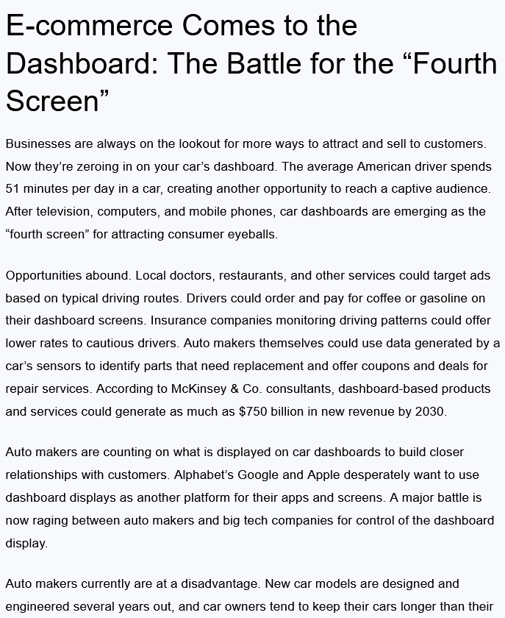
Students – please read this Case Study – next 3 slides - (take 5 minutes)

Slide 5
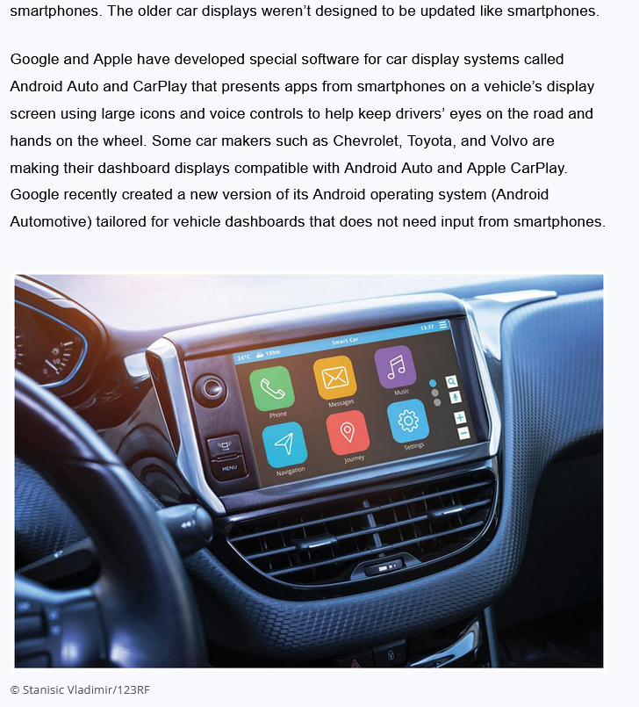

Slide 6
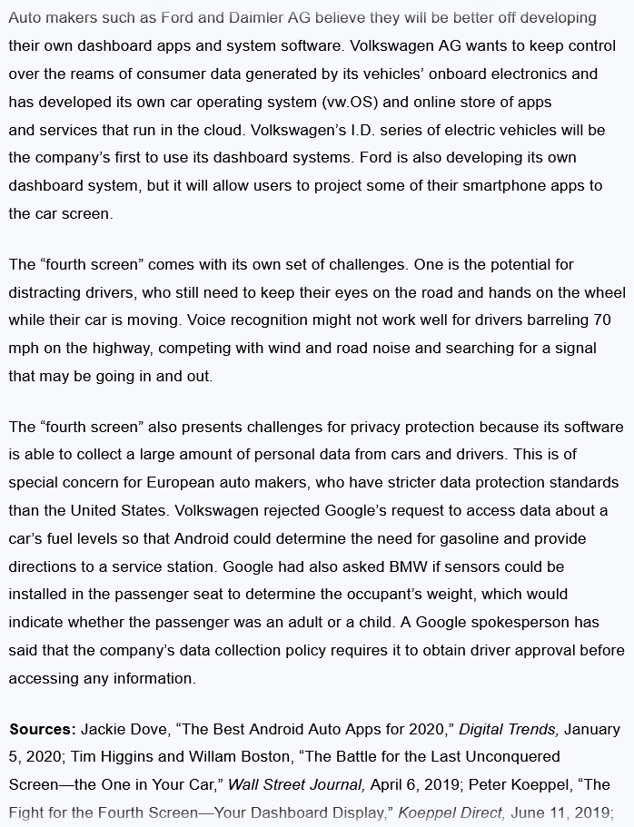

Slide 7
E-commerce Comes to the Dashboard: The Battle for the “Fourth Screen”
Problem
Opportunities presented by new technology
Solutions
Design business and revenue model
Partner with software providers
Data privacy restrictions
Design non-distracting interfaces
Dashboard display screens
Android Auto, Apple CarPlay, Android Automotive
Customer and auto databases

Slide 8
Major Trends
E-commerce moves to the automobile platform
Sales of information and services
Use of advanced data mining and location-based advertising
Big tech firms competing with major auto makers

Slide 9
E-commerce Today
E-commerce: Use of the Internet and Web to transact business
Began in 1995 and grew exponentially; still stable even in a recession
Companies that survived the dot-com bubble now thrive
The new e-commerce: social, mobile, local
Move from desktop to smartphone
Notes:
This slide discusses what e-commerce is, and what the state of e-commerce is today. E-commerce history mirrors that of other technology innovations. What other innovations is e-commerce similar to? Students probably will not know about the early days of radio and TV, but perhaps they will remember their parents’ cassette music, VHS video tapes, and even CDs and DVDs, which, though still with us, have markedly declined in sales. The book discusses new trends in e-commerce. Ask the students to work with you to list some of these new trends in e-commerce.

Slide 10
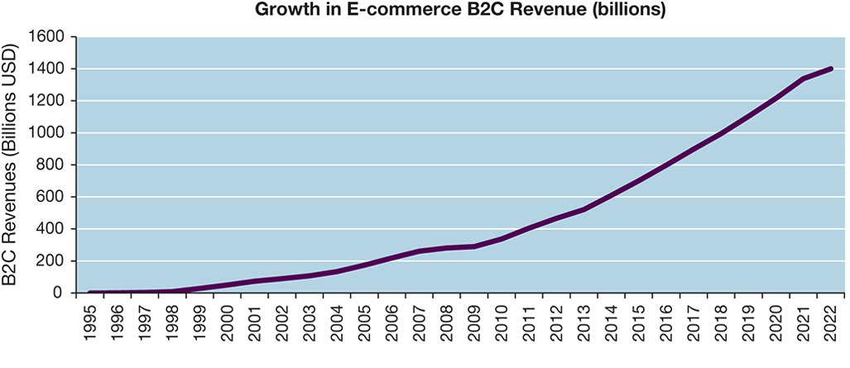
The Growth of E-commerce
Notes:
Figure 10.1, Page 374.
B2C e-commerce revenues grew 15–25 percent per year until the recession of 2008–2009, when they slowed measurably. In 2020, e-commerce revenues are expected to grow at an estimated 13 percent annually.
Sources: Based on data from eMarketer, “US Retail Ecommerce Sales,” 2020; eMarketer, “US Digital Travel Sales, 2018–2022,” 2020; authors’ estimates.
This graphic illustrates the continuing growth of e-commerce. The growth of e-commerce revenues grew 15 percent to 25 percent a year until the recession of 2008–2009, when they slowed measurably to a small positive number around 3 percent in 2009. This was much better than traditional retail commerce, which actually shrank in this recession. E-commerce began growing again after 2009 at more than 10 percent, several times the growth of all retail sales. Although the Covid-19 pandemic in 2020 has significantly decreased digital travel sales, it has resulted in a significant increase in retail e-commerce revenues, as consumers shift to online purchasing, a trend that is likely to continue even once the pandemic has passed.
Alt Text
Long description: A line graph explains how e-commerce revenues have grown over the years. The horizontal axis represents the years and ranges from 1995 to 2022, in increments of 1. The vertical axis represents the B2C revenues in billion Us dollars and ranges from 0 to 1600, in increments of 200.
The revenue from 1995 to the early 2000s is below 100 billion dollars. It gradually rises over the years and by the year 2010 the revenue triples to 400 billion dollars. From 2010 to 2020 the revenue increases drastically and reaches almost 1300 billion dollars. The projected revenue for the next two years 2021 and 2022 shows the revenue surging to 1400 billion dollars.

Slide 11
Why E-commerce is Different
Ubiquity
Marketspace is virtual
Transaction costs reduced
Global reach
Transactions cross cultural and national boundaries
Universal standards
One set of technology standards: Internet standards
Richness
Supports video, audio, and text messages
Notes:
This slide introduces the unique features of the Internet. These features explain why e-commerce has grown so quickly—because of the unique nature of the Internet and e-commerce, which are richer and more powerful than previous technology revolutions such as radio and TV.
Ask students to provide real-life examples of these effects, for example:
Ubiquity—being able to surf the web on your mobile device while riding a bus or train.
Global reach—being able to buy products from another country.
Universal standards—being able to exchange files with someone else.
Richness—YouTube.

Slide 12
Why E-commerce is Different (cont’)
Interactivity
Information density
Greater price and cost transparency
Enables price discrimination
Personalization/customization
Technology permits modification of messages, goods
Social technology
Promotes user content generation and social networking
Notes:
Ask students to provide real-life examples of these effects, for example:
Interactivity—using a chat window to interact with technical support at a merchant’s website.
Information density—being able to find hundreds of prices for the same product online from different merchants.
Personalization—website that adjusts to your preferences, such as Amazon.
Social technology—uploading videos to YouTube.

Slide 13
Key Concepts in E-commerce – Digital Markets and Digital Goods in a Global Marketplace
Internet and digital markets have changed the way companies conduct business
Information asymmetry reduced
Menu costs, search and transaction costs reduced
Dynamic pricing enabled
Switching costs
Delayed gratification
Disintermediation
Notes:
This slide introduces digital markets and discusses the effects of digital markets on the ways companies conduct business. Ask students to define the terms listed here, and also to explain how each of these effects (lowered information asymmetry, etc.) are created by digital markets. Go through each of the three types of costs involved in any marketplace. Students may not be familiar with these concepts, but they will be familiar with the phenomenon. For instance, all students will recognize that it takes time and money to go to a mall to find a shirt (this is search cost). The same shirt can be bought on the Web today with minimal search costs.

Slide 14
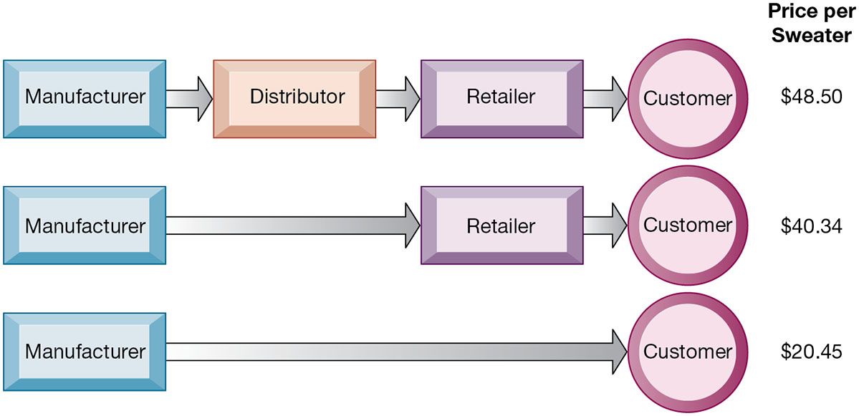
The Benefits of Disintermediation to the Consumer
Notes:
Figure 10.2, Page 381.
The typical distribution channel has several intermediary layers, each of which adds to the final cost of a product, such as a sweater. Removing layers lowers the final cost to the customer.
This graphic illustrates how disintermediation reduces prices to consumers. It also allows manufacturers to earn more profit for the product by eliminating the middleperson. Are middlepeople really necessary? You should ask students who they think is a “middleperson.” Walmart is, for instance, a distributor and retailer. Do they provide an important function? Why can’t manufacturers just ignore Walmart and sell directly to the customer? Even though market disintermediation sounds like a good thing because costs and prices go down, for the most part manufacturers kept their distribution partners and channels. Walmart is still needed by manufacturers such as P&G to sell soap.
Alt Text
Long description: A series of flow diagrams illustrate the benefits of removal of intermediaries from a sample supply chain. The details are as below:
Flow diagram 1: Manufacturer; Distributor; Retailer; Customer; Price per sweater, $48.50.
Flow diagram 2: Manufacturer; Retailer; Customer; Price per sweater, $40.34.
Flow diagram 3: Manufacturer to customer; Price per sweater, $20.45.

Slide 15
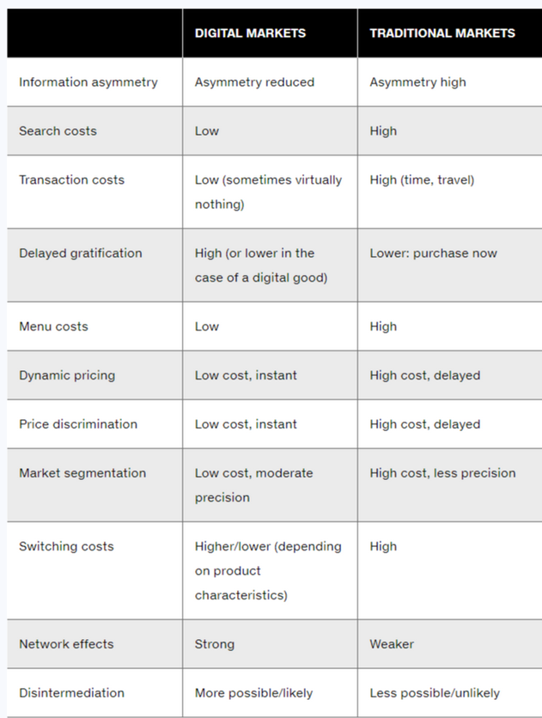
Digital vs Traditional Markets
Notes:
Figure 10.2, Page 381.
The typical distribution channel has several intermediary layers, each of which adds to the final cost of a product, such as a sweater. Removing layers lowers the final cost to the customer.
This graphic illustrates how disintermediation reduces prices to consumers. It also allows manufacturers to earn more profit for the product by eliminating the middleperson. Are middlepeople really necessary? You should ask students who they think is a “middleperson.” Walmart is, for instance, a distributor and retailer. Do they provide an important function? Why can’t manufacturers just ignore Walmart and sell directly to the customer? Even though market disintermediation sounds like a good thing because costs and prices go down, for the most part manufacturers kept their distribution partners and channels. Walmart is still needed by manufacturers such as P&G to sell soap.
Alt Text
Long description: A series of flow diagrams illustrate the benefits of removal of intermediaries from a sample supply chain. The details are as below:
Flow diagram 1: Manufacturer; Distributor; Retailer; Customer; Price per sweater, $48.50.
Flow diagram 2: Manufacturer; Retailer; Customer; Price per sweater, $40.34.
Flow diagram 3: Manufacturer to customer; Price per sweater, $20.45.

Slide 16
Digital Goods
Goods that can be delivered over a digital network
Cost of producing first unit is almost entire cost of product
Costs of delivery over the Internet very low
Marketing costs remain the same; pricing highly variable
Industries with digital goods are undergoing revolutionary changes (publishers, record labels, etc.)
Notes:
This slide continues the discussion of key concepts in e-commerce, looking at digital goods and how these compare with traditional goods.
Ask students how their purchases of digital goods have changed over the past five years. What benefits and drawbacks do they have? Music for instance used to be a physical product (record or CD) not a digital product or digital service.

Slide 17
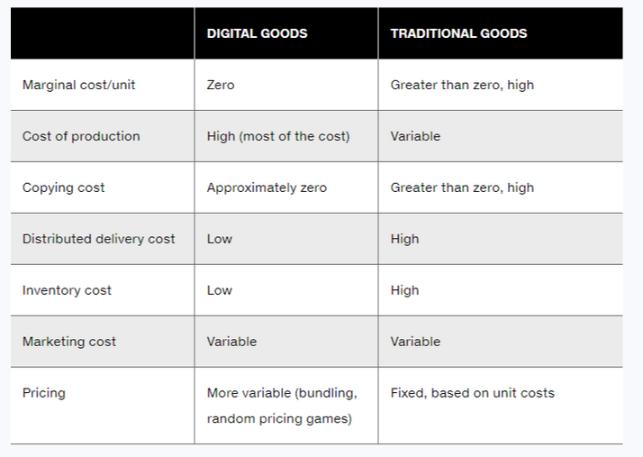
INTERNET Affect on Digital Goods
Notes:
Figure 10.2, Page 381.
The typical distribution channel has several intermediary layers, each of which adds to the final cost of a product, such as a sweater. Removing layers lowers the final cost to the customer.
This graphic illustrates how disintermediation reduces prices to consumers. It also allows manufacturers to earn more profit for the product by eliminating the middleperson. Are middlepeople really necessary? You should ask students who they think is a “middleperson.” Walmart is, for instance, a distributor and retailer. Do they provide an important function? Why can’t manufacturers just ignore Walmart and sell directly to the customer? Even though market disintermediation sounds like a good thing because costs and prices go down, for the most part manufacturers kept their distribution partners and channels. Walmart is still needed by manufacturers such as P&G to sell soap.
Alt Text
Long description: A series of flow diagrams illustrate the benefits of removal of intermediaries from a sample supply chain. The details are as below:
Flow diagram 1: Manufacturer; Distributor; Retailer; Customer; Price per sweater, $48.50.
Flow diagram 2: Manufacturer; Retailer; Customer; Price per sweater, $40.34.
Flow diagram 3: Manufacturer to customer; Price per sweater, $20.45.

Slide 18
Types of E-commerce
Three major types
Business-to-consumer (B2C)
Example: Amazon.com
Business-to-business (B2B)
Example: Elemica
Consumer-to-consumer (C2C)
Example: eBay
E-commerce can be categorized by platform
Mobile commerce (m-commerce)
Notes:
This slide introduces the types of e-commerce. B2C, B2B, and C2C e-commerce are categorized according to the nature of the participants. M-commerce is a category based on the nature of the connection to the Internet. Ask students to provide examples of the different types of e-commerce listed here. Most students will find it hard to come up with a B2B example. One place you can visit on the Web is grainger.com, one of the largest B2B marketplaces in the United States. Another is mcmaster.com.

Slide 19
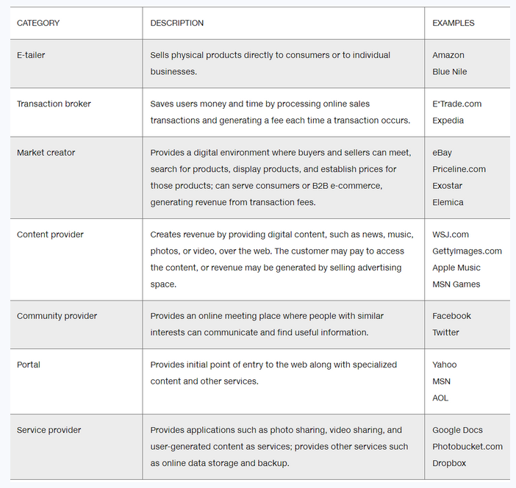
E-commerce Business Models
Notes:
This slide discusses new business models that are enabled by the Internet and e-commerce. Although many of the business models are pure-play, some, especially in the retail industry, are clicks-and-mortar. Ask students to give examples of these business models. For each model, ask students about their experience, or ask for examples for each model.
Some of the business models take advantage of the Internet’s communication capabilities, such as the social networking sites. Ask students what other sites take advantage of the Internet’s communication abilities.

Slide 20
E-commerce Revenue Models
Advertising
Sales
Subscription
Free/Freemium
Transaction fee
Affiliate
Notes:
This slide discusses various revenue models that are used by e-commerce companies. Ask how the various business models listed in the previous slide create revenue. For instance:
Content provider revenue: access fees, advertising
Portal revenue: advertising
Service provider revenue: subscription fees, advertising
Community provider (could be Facebook) revenue: sales of virtual goods, display ads

Slide 21
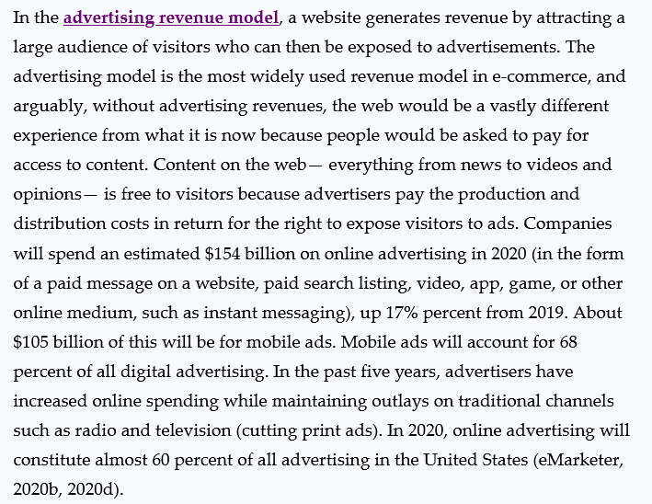
Advertising Revenue Model
Notes:
This slide discusses various revenue models that are used by e-commerce companies. Ask how the various business models listed in the previous slide create revenue. For instance:
Content provider revenue: access fees, advertising
Portal revenue: advertising
Service provider revenue: subscription fees, advertising
Community provider (could be Facebook) revenue: sales of virtual goods, display ads

Slide 22
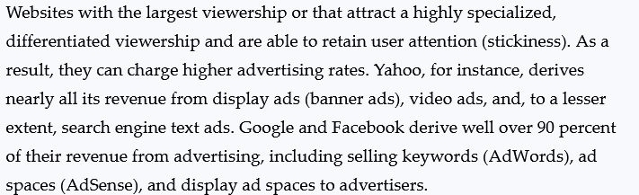
Advertising Revenue Model (cont’)
Notes:
This slide discusses various revenue models that are used by e-commerce companies. Ask how the various business models listed in the previous slide create revenue. For instance:
Content provider revenue: access fees, advertising
Portal revenue: advertising
Service provider revenue: subscription fees, advertising
Community provider (could be Facebook) revenue: sales of virtual goods, display ads

Slide 23
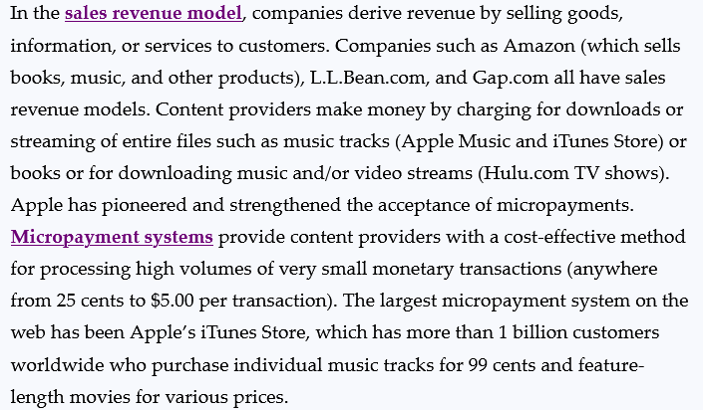
Sales Revenue Model
Notes:
This slide discusses various revenue models that are used by e-commerce companies. Ask how the various business models listed in the previous slide create revenue. For instance:
Content provider revenue: access fees, advertising
Portal revenue: advertising
Service provider revenue: subscription fees, advertising
Community provider (could be Facebook) revenue: sales of virtual goods, display ads

Slide 24
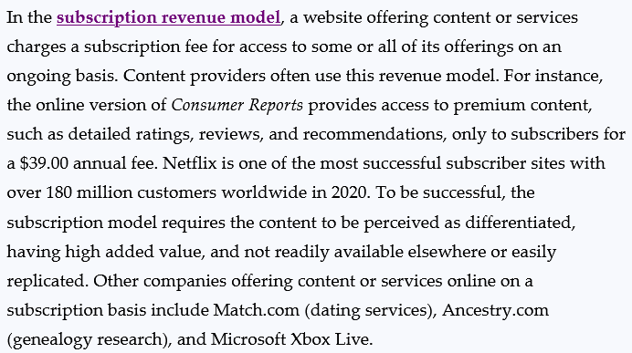
Subscription Revenue Model
Notes:
This slide discusses various revenue models that are used by e-commerce companies. Ask how the various business models listed in the previous slide create revenue. For instance:
Content provider revenue: access fees, advertising
Portal revenue: advertising
Service provider revenue: subscription fees, advertising
Community provider (could be Facebook) revenue: sales of virtual goods, display ads

Slide 25
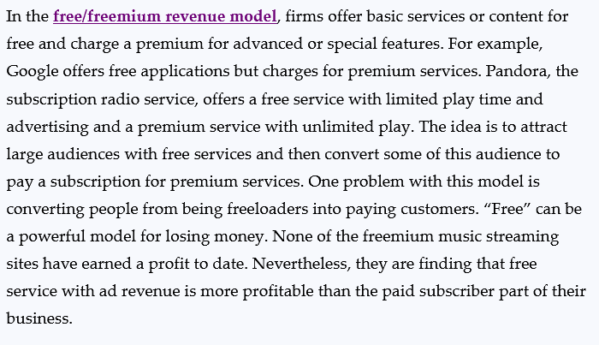
Free/Freemium Revenue Model
Notes:
This slide discusses various revenue models that are used by e-commerce companies. Ask how the various business models listed in the previous slide create revenue. For instance:
Content provider revenue: access fees, advertising
Portal revenue: advertising
Service provider revenue: subscription fees, advertising
Community provider (could be Facebook) revenue: sales of virtual goods, display ads

Slide 26
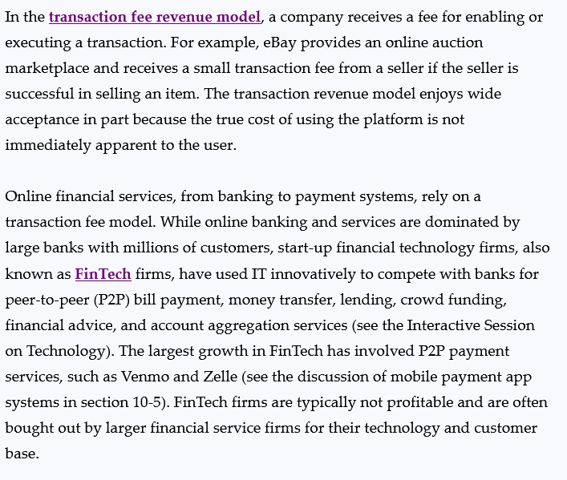
Transaction Fee Revenue Model
Notes:
This slide discusses various revenue models that are used by e-commerce companies. Ask how the various business models listed in the previous slide create revenue. For instance:
Content provider revenue: access fees, advertising
Portal revenue: advertising
Service provider revenue: subscription fees, advertising
Community provider (could be Facebook) revenue: sales of virtual goods, display ads

Slide 27
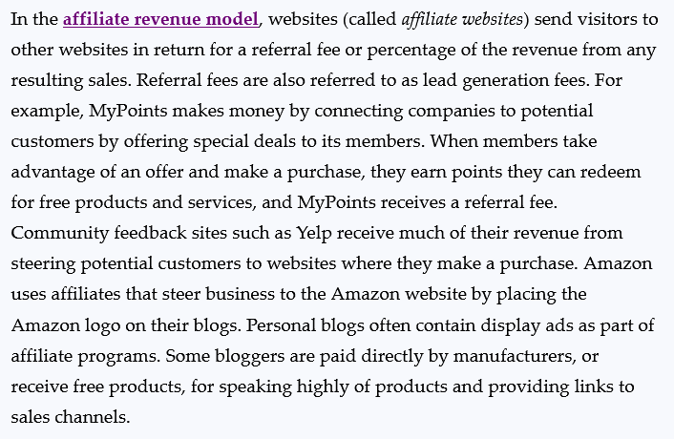
Affiliate Revenue Model
Notes:
This slide discusses various revenue models that are used by e-commerce companies. Ask how the various business models listed in the previous slide create revenue. For instance:
Content provider revenue: access fees, advertising
Portal revenue: advertising
Service provider revenue: subscription fees, advertising
Community provider (could be Facebook) revenue: sales of virtual goods, display ads

Slide 28
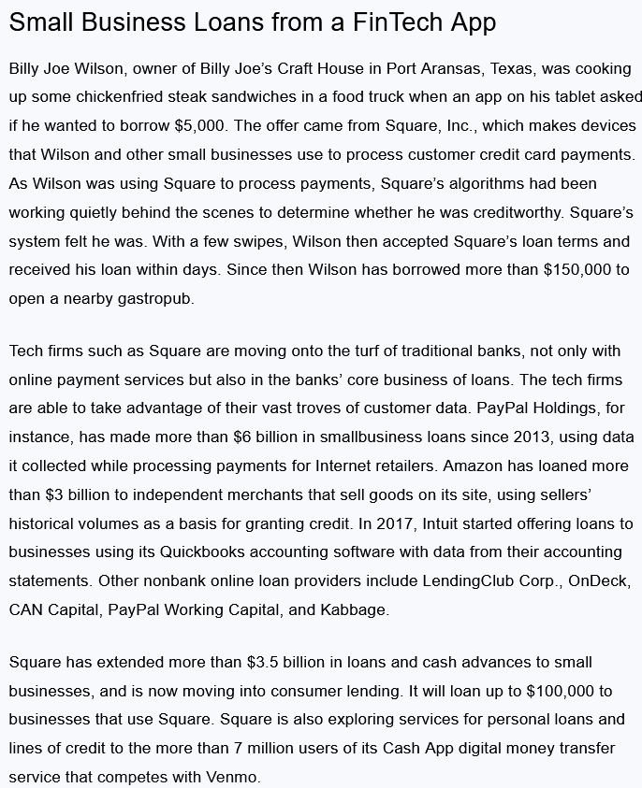
Students – please read this Case Study – next 3 slides - (take 5 minutes)

Slide 29
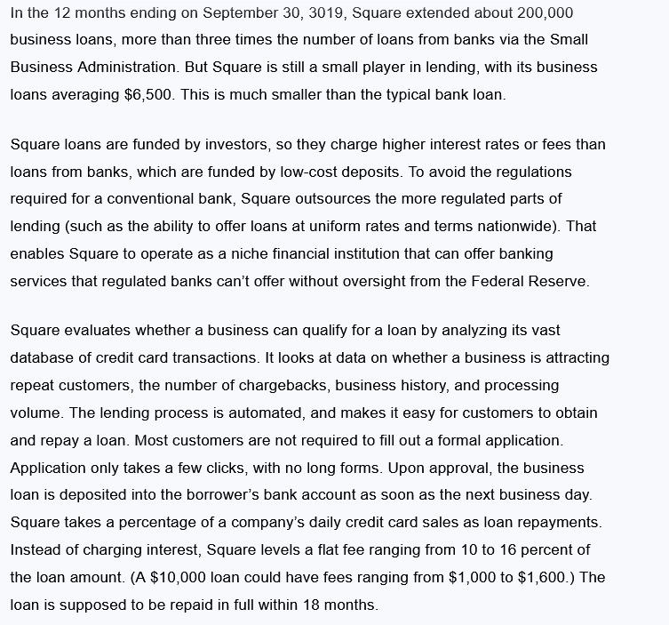

Slide 30
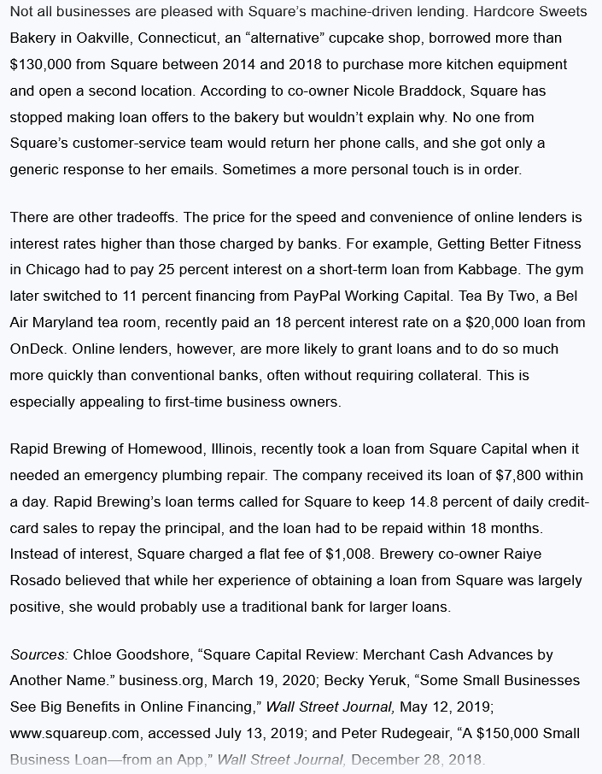

Slide 31
Small Business Loans from a FinTech App - Case Study Questions
What distinguishes the FinTech services described in this case from traditional banks?
How do the financial services described here use information technology to innovate?
What are the advantages of small businesses obtaining loans from FinTech services?
What are the disadvantages of small businesses obtaining loans from FinTech services?
If you were a small business, what factors would you consider in deciding whether to use a FinTech service?

Slide 32

主观题
10分
1）What distinguishes the FinTech services described in this case from traditional banks?
2）How do the financial services described here use information technology to innovate?
3）What are the advantages of small businesses obtaining loans from FinTech services?
4）What are the disadvantages of small businesses obtaining loans from FinTech services?
5）If you were a small business, what factors would you consider in deciding whether to use a FinTech service?
作答

Slide 33
How Has E-commerce Transformed Marketing?
Internet provides new ways to identify and communicate with customers
Long tail marketing (large amount or products or online content where profits are made from low demand items as well as popular ones. Shelf space is non-essential online)
Different marketing and advertising formats
- Search - Display Ads -Video Media -Email
Notes:
Search engine advertising generates the largest amount of online ad spending, followed by online video advertising, which is the fastest growing format. Ask students how they interact with online advertising. Do they watch online video ads all the way through. Do they click on display ads? Do they respond to email marketing messages?

Slide 34
How Has E-commerce Transformed Marketing? (cont’)
Behavioral targeting
Tracking online behavior of individuals
On individual websites/apps and across advertising networks
Programmatic ad buying
Native advertising
Notes:
Ask students if they have experienced behavioral tracking as they surf the web. Do they notice online advertising that appears to be related to content they have previously viewed. You can also ask students about experiences, if any, with native advertising. Have they ever viewed online content that they did not realize was actually an ad?

Slide 35
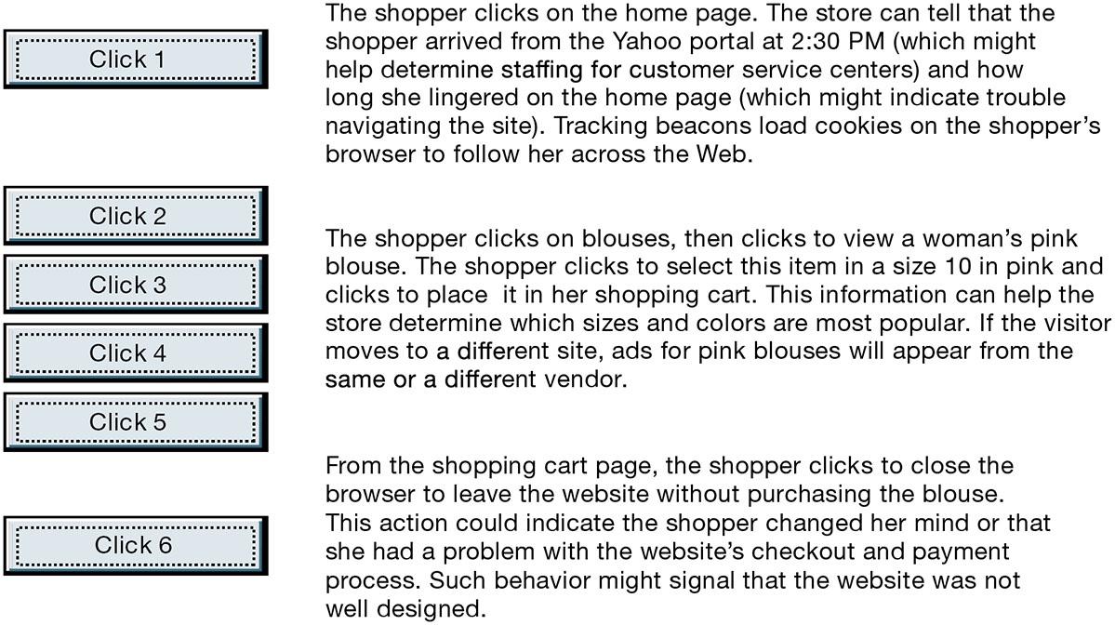
Website Visitor Tracking
Notes:
Figure 10.3, Page 392.
E-commerce websites and advertising platforms like Google Marketing Platform have tools to track a shopper’s every step through an online store and then across the web as shoppers move from site to site. Close examination of customer behavior at a website selling women’s clothing shows what the store might learn at each step and what actions it could take to increase sales. © Google LLC, uses with permission. Google and the Google logo are registered trademarks of Google LLC.
This graphic illustrates how clickstream tracking works and what the store can tell about the activities of a shopper on its website. Extensive metrics exist for various types of user behavior, from the time spent on a web page to the number of products ordered and placed in a shopping cart but not purchased.
Alt Text
Long description: An illustration explains how websites have visitor tracking tools that analyze a visitor’s behavior. The details are as below:
Click 1: The shopper clicks on the home page. The store can tell that the shopper arrived from the Yahoo portal at 2:30 PM (which might help determine sta­ffing for customer service centers) and how long she lingered on the home page (which might indicate trouble navigating the site). Tracking beacons load cookies on the shopper’s browser to follow her across the web.
Clicks 2 to 5: The shopper clicks on blouses, then clicks to view a woman’s pink blouse. The shopper clicks to select this item in a size 10 in pink and clicks to place it in her shopping cart. This information can help the store determine which sizes and colors are most popular. If the visitor moves to a different site, ads for pink blouses will appear from the same or a different vendor.
Click 6: From the shopping cart page, the shopper clicks to close the browser to leave the website without purchasing the blouse. This action could indicate the shopper changed her mind or that she had a problem with the website’s checkout and payment process. Such behavior might signal that the website was not well designed.

Slide 36
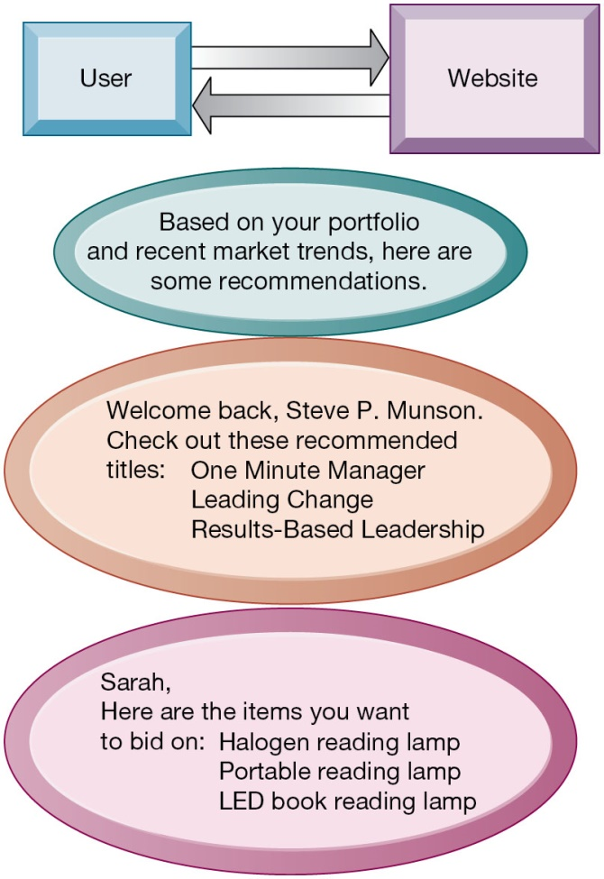
Website Personalization
Notes:
Figure 10.4, Page 392.
Firms can create unique personalized web pages that display content or ads for products or services of special interest to individual users, improving the customer experience and creating additional value.
This graphic illustrates some of the types of personalization that clickstream tracking can make possible. Have students found suggestions made by a website useful in their experience? You can go to Amazon.com and illustrate how recommender systems work. Search for a product, and then scroll to the bottom of the page where Amazon’s recommender will tell you what other people who looked at the current page actually bought. Netflix is also an excellent site to demonstrate personalization.
Alt Text
Long description: A flow diagram illustrates the concept of website personalization. Examples are shown for two different users:
The user and the website communicate. Based on the portfolio and recent market trends, some recommendations are provided to the users:
Welcome back, Steve P. Munson. Check out these recommended titles: One Minute Manager; Leading Change; Results-Based Leadership.
Sarah, here are the items you want to bid on: Halogen reading lamp; Portable reading lamp; LED book reading lamp.

Slide 37
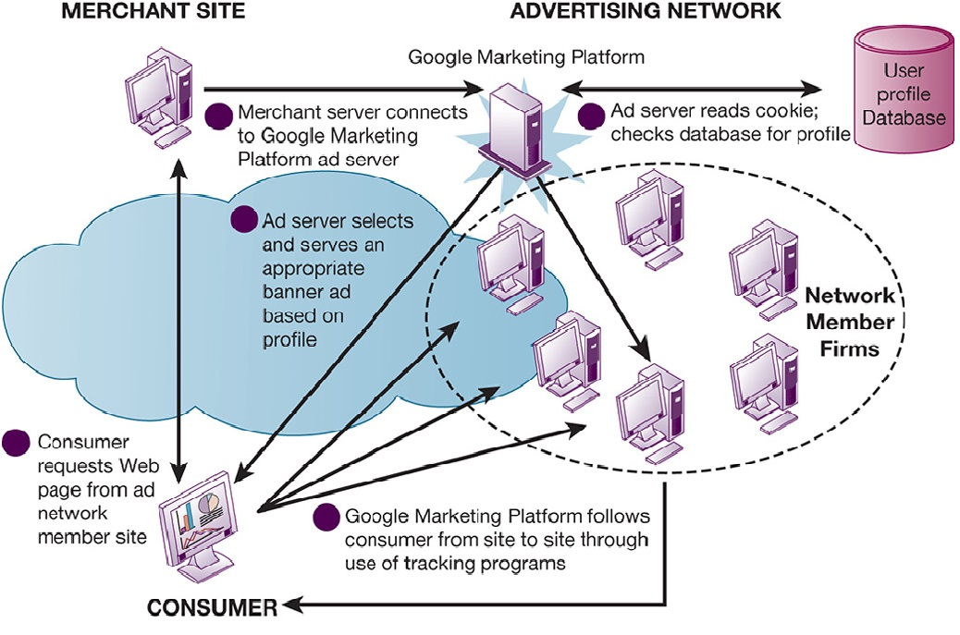
How an Advertising Network Works
Notes:
Figure 10.5, Page 393.
Advertising networks and their use of tracking programs have become controversial among privacy advocates because of their ability to track individual consumers across the Internet.
What do students think (or do they think) about how advertising networks follow them around the Internet? It’s actually quite difficult for anyone to know when they are being tracked by a network, and even more difficult to find out how the information is being used.
Alt Text
Long description: A network diagram illustrates how an advertising network works. The merchant site, advertising network, and the consumer are depicted in a flow in this diagram.
The details are as below:
Merchant server connects to Google Marketing Platform ad server.
Ad server reads cookie; checks database for profile before communicating with the user profile database. The communication is both ways and is depicted by a bidirectional arrow.
The server in the meantime also communicates with several network member firms as well as the consumer.
The network member firms communicate with the consumer.
The consumer communicates with the various network member firms. Google Marketing Platform follows consumer from site to site through use of tracking programs.
The consumer and the merchant site communicate with each other. The communication is both ways and is depicted by a bidirectional arrow.
Consumer requests webpage from ad network member site and the ad server selects and serves an appropriate banner ad based on profile.

Slide 38
Social E-commerce and Social Network Marketing
Social media one of fastest growing branding and marketing methods
Social e-commerce based on digital social graph
Features
Newsfeed
Timelines
Social sign-on
Collaborative shopping
Network notification
Social search (recommendations)
Notes:
Ask students why they think social media is one of the fastest-growing methods for branding and marketing. What social networks do they frequent, and what features of social networks do they use?

Slide 39
Social E-commerce and Social Network Marketing (cont’)
Social network marketing
Seeks to leverage individuals’ influence over others
Targeting a social network of people sharing interests and advice
Facebook’s “Like” button
Social networks have huge audiences
Social shopping sites
Wisdom of crowds
Crowdsourcing
Notes:
Ask students if they many click routinely on ads or other sponsored content? How many have purchased something as a result of an ad they have seen on a social network?
Other types of social network marketing involve the “wisdom of the crowd” and crowdsourcing. Ask students if they have ever supported a Kickstarter or project on a similar platform.

Slide 40
How Has E-commerce Affected Business-To Business Transactions?
U.S. B2B trade in 2020 estimated at about $14.5 trillion
U.S. B2B e-commerce in 2020 estimated at $6.7 trillion
Internet and networking helps automate procurement
Variety of Internet-enabled technologies used in B2B
Electronic data interchange (E D I)
Private industrial networks (private exchanges)
Net marketplaces
Exchanges
Notes:
This slide looks at changes brought to B2B e-commerce by Internet technologies. Note that the Internet and web technology enable businesses to create new electronic storefronts for selling to other businesses with multimedia graphic displays and interactive features similar to those for B2C commerce. Alternatively, businesses can use Internet technology to create extranets or electronic marketplaces for linking to other businesses for purchase and sale transactions.

Slide 41
Electronic Data Interchange (E D I)
Computer-to-computer exchange of standard transactions such as invoices, purchase orders
Major industries have E D I standards
Define structure and information fields of electronic documents
More companies are moving toward web-enabled private networks
Allow them to link to a wider variety of firms than E D I allows
Enable sharing a wider range of information

Slide 42
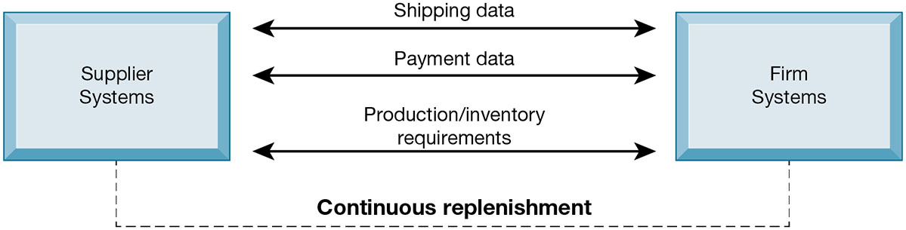
Electronic Data Interchange (E D I)
Notes:
Figure 10.6, Page 398.
Companies use EDI to automate transactions for B2B e-commerce and continuous inventory replenishment. Suppliers can automatically send data about shipments to purchasing firms. The purchasing firms can use EDI to provide production and inventory requirements and payment data to suppliers.
This graphic illustrates EDI is still widely used but it has limitations, as outlined in the book, and is not designed for supporting marketplace operations where you have hundreds of vendors and buyers.
Alt Text
Long description: An illustration explains how companies use EDI to automate transactions for B2B e-commerce and continuous replenishment. The interaction takes place between the supplier systems and firm systems for the following and in a way aid the continuous inventory replenishment:
Shipping data
Payment data
Production and inventory requirements.

Slide 43
New Ways of B2B Buying and Selling
Private industrial networks
Private exchanges
Large firm using a secure website to link to suppliers and partners
Net marketplaces (e-hubs)
Single digital marketplace for many buyers and sellers
May focus on direct or indirect goods
May be vertical or horizontal marketplaces
Exchanges
Independently owned third-party Net marketplaces for spot purchasing
Notes:
This slide continues the discussion of ways the Internet and web technologies have changed B2B e-commerce. One way is in using a private industrial network to link to the firm’s suppliers. The text provides the example of VW Group Supply, which links the Volkswagen Group and its suppliers. VW Group Supply handles 90 percent of all global purchasing for Volkswagen, including all automotive and parts components.
This slide continues the discussion of ways the Internet and web technologies have changed B2B e-commerce, in this case by the ability to create Net marketplaces. Ask students to distinguish between and provide examples of direct and indirect goods. (Direct goods are goods used in a production process, such as sheet steel for auto body production. Indirect goods are all other goods not directly involved in the production process, such as office supplies or products for maintenance and repair.)
Ask students to distinguish between vertical and horizontal marketplaces.
This slide continues the discussion of ways the Internet and web technologies have changed B2B e-commerce, in this case by the ability to create exchanges. The text provides the example of GoToPaper, which creates a spot market for paper products in 75 countries.

Slide 44
Mobile Commerce (M-commerce)
M-commerce in 2020 is about 45 percent of all e-commerce
Fastest growing form of e-commerce (20% or more per year)
Most Important M-commerce Applications Banking.
Banking (Amazon, eBay, Etsy etc.)
Retail (in-app sales to mobile devices)
Mobile Marketing (funnels, click advertising)
Mobile Ticketing (sports, concerts, theatre etc.)
Reservations (restaurants, transportation)
Appointments (medical, car dealership, interviews)
Main areas of growth
Mass market retailing (Amazon, eBay, etc.)
Sales of digital content (music, TV, etc.)
In-app sales to mobile devices
Notes:
This slide introduces m-commerce, the use of wireless mobile devices for purchasing goods and services. Ask students what applications and services they use with their cell phones. Have any purchased games or entertainment, and from what companies? Have any used OpenTable on a smartphone?

Slide 45
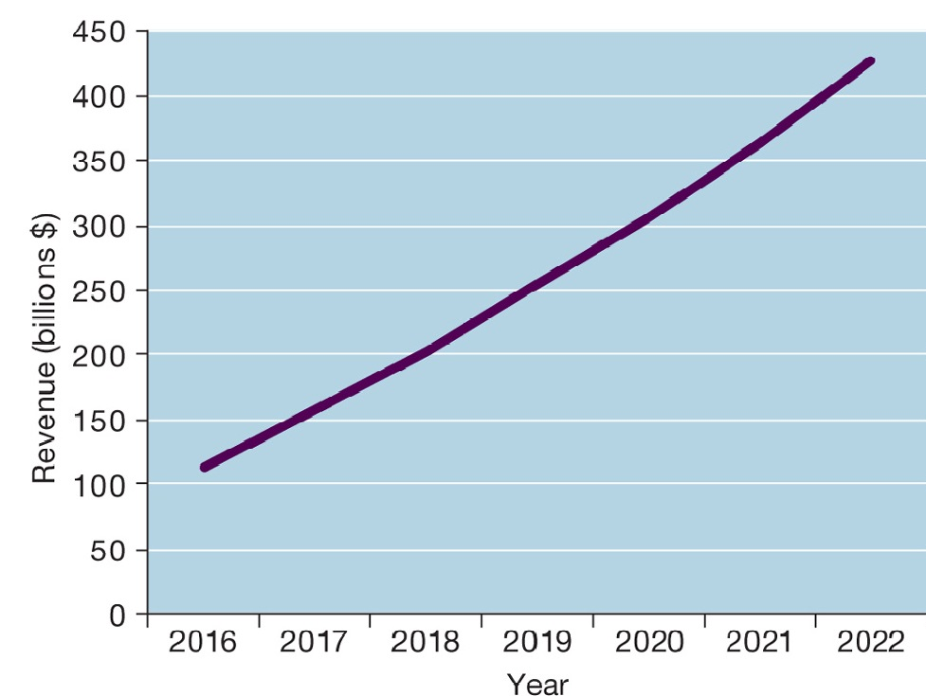
Mobile Retail Commerce Revenues
Notes:
Figure 10.9, Page 401.
Mobile e-commerce is the fastest-growing type of B2C e-commerce. By 2021, m-commerce sales are expected to account for 54 percent of total e-commerce sales.
Source: Data from eMarketer chart “US Retail Mcommerce Sales,” 2020”
This graph illustrates the surging growth of m-commerce sales from 2016 to 2022. In the early years prior to 2009, m-commerce in the United States was very small and not growing rapidly. Cell phones, especially smartphones, have changed that. Have any of the students purchased something using their cell phone or mobile laptop computer? How many students are using a smartphone? How many have used a smartphone app to compare prices while shopping at stores?
Alt Text
Long description: A line graph explains how mobile e-commerce revenues have increased over the years. The horizontal axis represents the years and ranges from 2016 to 2022, in increments of 1. The vertical axis represents the revenue in billions of dollars and ranges from 0 to 450 in increments of 50.
The revenue curve is a steep upward curve which appears to be gradually increasing over the years from approximately 110 billion dollars in the year 2016 and projected to reach almost 450 billion dollars by the year 2022.

Slide 46
Location-Based Services
Used by 74 percent of smartphone owners
Based on G P S map services
Geosocial services
Where friends are
Geo advertising
What shops are nearby
Geo information services
Price of house you are passing
Notes:
Google Maps is arguably the most common example of location-based services. Foursquare is another good example.

Slide 47
Other Mobile Commerce Services
Financial account management apps
Banks, credit card companies
Mobile advertising market
Google and Facebook are largest markets
Ads embedded in games, videos, and mobile apps
Over 45 percent of top retailers have m-commerce websites
Virtually all large traditional and online retailers have m-commerce apps.
Notes:
Ask students how many have purchased a product or service using an m-commerce website or app. How did the experience differ, if at all, from using a desktop or laptop?

Slide 48
Mobile App Payment Systems
Near Field Communication (NFC)
Apple Pay, Google Pay, Samsung Pay
QR Code
Starbucks, Walmart, Target, Dunkin Donuts
Peer-to-peer (P2P) payment systems
Venmo, Zelle
Notes:
Ask students about their experiences using mobile app payment systems. How many have used one of the various types listed on this slide? Have mobile app payment systems replaced using cash, or credit or debit cards?

Slide 49
What Issues Must Be Addressed When Building an E-commerce Presence?
Most important management challenges
Developing clear understanding of business objectives
Knowing how to choose the right technology to achieve those objectives
Develop an e-commerce presence map
Four areas: websites, e-mail, social media, offline media
Develop a timeline: milestones
Breaking a project into discrete phases
Notes:
Building a website involves a number of considerations. If its an e-commerce site, customer preferences should be the driving force behind the design. What are customers looking for, how can they find it on your site, and how easily can they purchase on your site? How will you choose the technology? What about your site’s information policy? What’s that? If you don’t know, your customers will surely expect you to know.

Slide 50
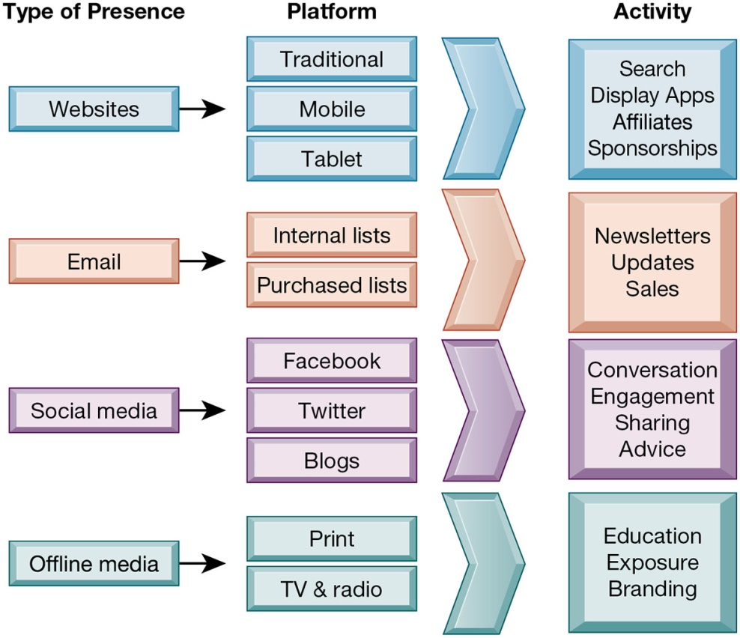
E-commerce Presence Map
Notes:
Figure 10.10, Page 405.
An e-commerce presence requires firms to consider the four types of presence, with specific platforms and activities associated with each.
Alt Text
Long description: A process diagram depicts an e-commerce presence map. The details are as follows:
Type of presence: Website; Platforms: Traditional, mobile, and tablet; Activity: Search display apps, affiliates, and sponsorships.
Type of presence: Email; Platforms: Internal and purchased lists; Activity: Newsletters, updates, and sales.
Type of presence: Social media; Platforms: Facebook, Instagram, twitter, and blogs; Activity: Conversation, engagement, sharing advice.
Type of presence: Offline media; Platforms: Print, TV, and radio; Activity: Education, exposure, and branding.

Slide 51
KAHOOT TIME!!!

Slide 52
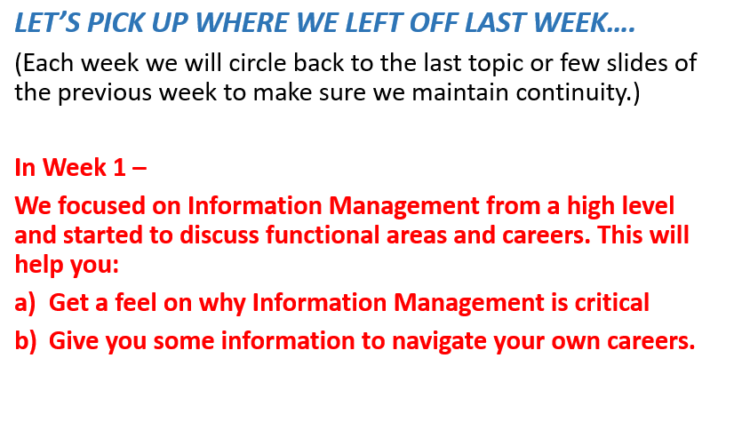
Assignment For Week 10 – Chapter 10
Read the Case Study on next 3 slides and
answer the four(4) questions that follow.

Slide 53
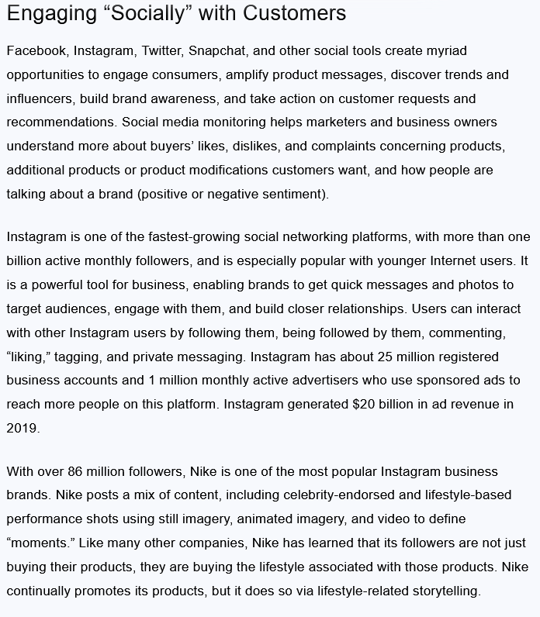
Students – please read this Case Study for Homework (answer 4 questions that follow.

Slide 54
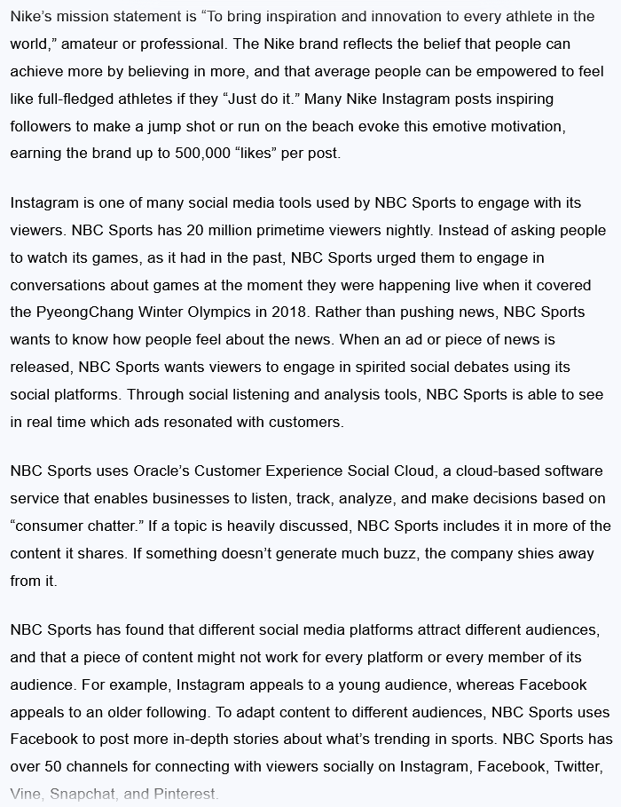

Slide 55
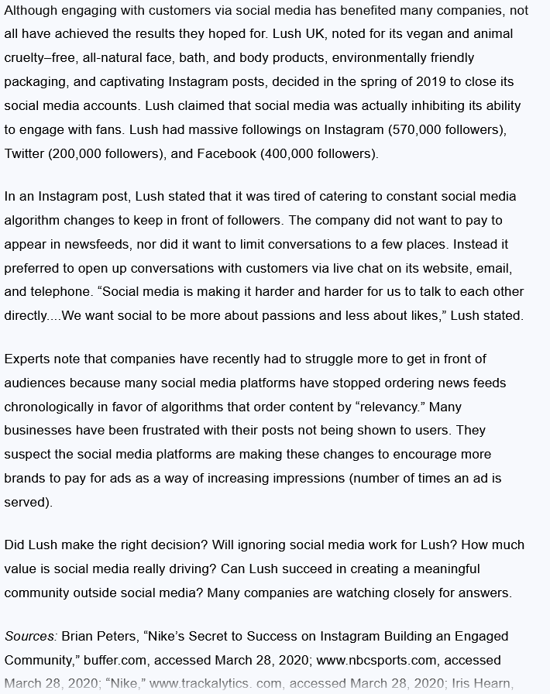

Slide 56
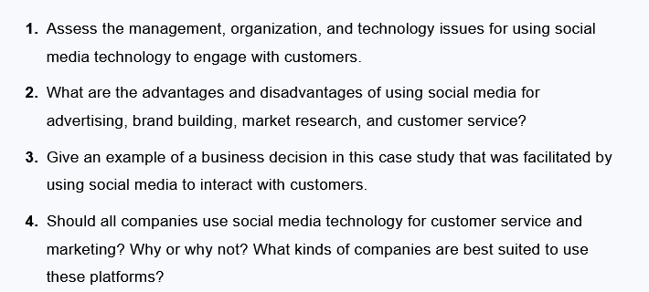
Homework Questions:

